Slide 1

SEEB-GPU: Early-Exit Aware Scheduling and Batching for Edge GPU Inference
Srinivasan Subramaniyan, Rudra Joshi, Xiaorui Wang, Marco Brocanelli
This work is supported, in part, by the U.S. NSF under awards CNS-2149533 and CNS-2421244

Slide 2




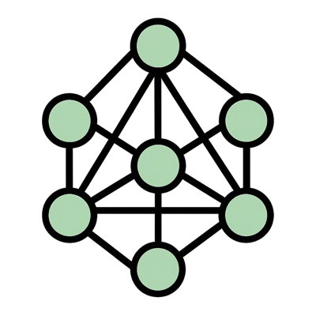


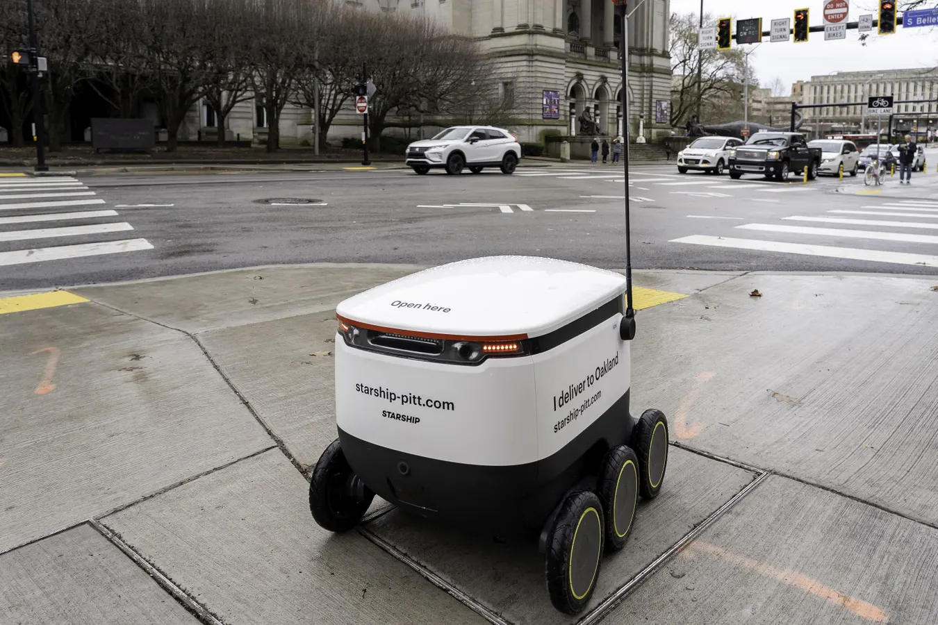

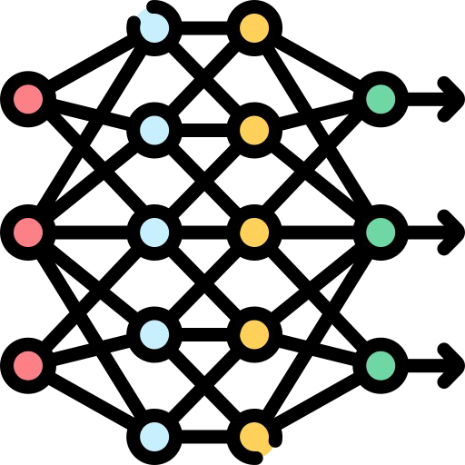
Why Edge Image Processing?
Deep Neural Networks (DNNs) are used in several applications
Smart surveillance, robot navigation, and augmented reality
Need for real-time processing for smooth, responsive performance.
Limited mobile processing capabilities
Offload inference to nearby edge server GPUs
Many devices offload to the same edge GPU
How to manage latency on edge GPU?
GPU allocation per request
Batch size
Model structure

Slide 3
DNN Inference on Edge-GPUs
Sequential Scheduling
Tasks run sequentially.
Large idle gaps → low utilization.
Concurrent Scheduling
Tasks run concurrently via time slicing.
Improves fairness, but adds context switching overhead
Spatial Scheduling (more complex)
GPU is partitioned among tasks.
Can minimize interference using spatial split.
Achieves high utilization and predictable latency.
Sequential
T1
T2
T3
Time-slicing
Spatial Sharing
T3
T2
T1

Slide 4
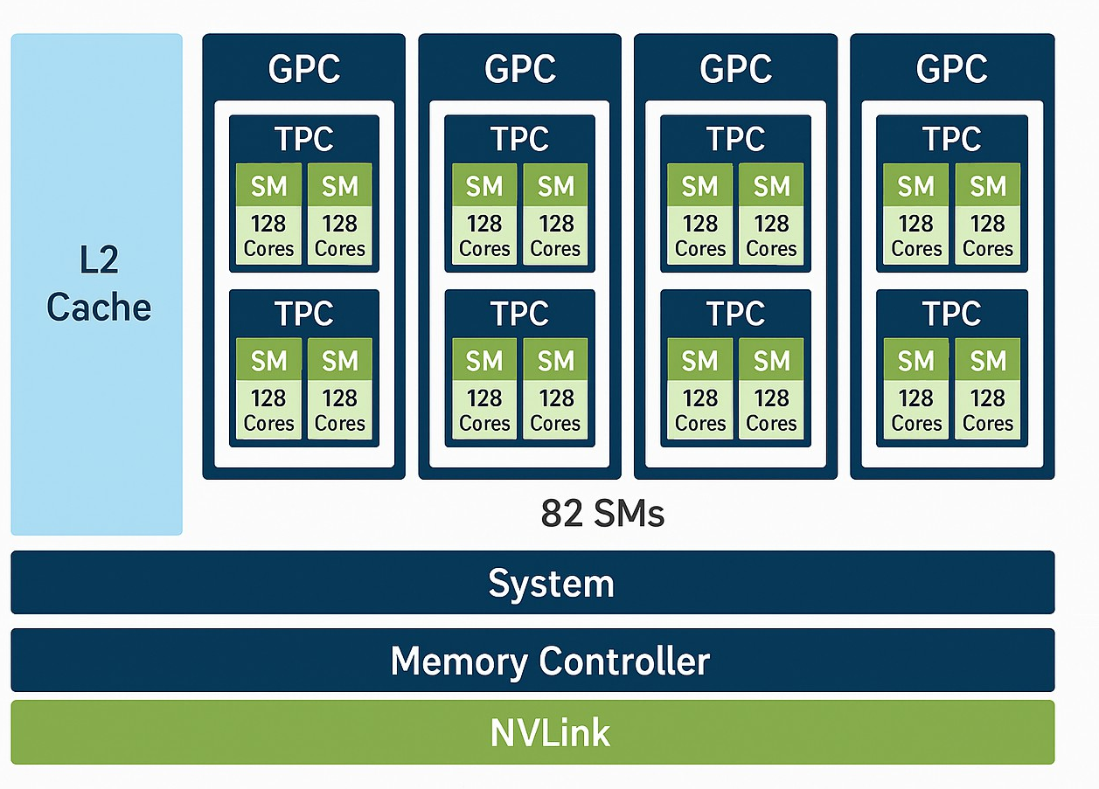
Edge-GPU Spatial Sharing Notation
In general, GPUs are divided in:
GPCs (Graphics Processing Clusters)
TPCs (Thread Processing Clusters)
SMs (Streaming Multiprocessors)
Can be achieved through MPS or TPC Masking
Offloading Requests
Task Queue
D
C
B
A
Allocation
Example Ampere Architecture

Slide 5
MPS vs TPC Masking
We use this!
MPS (Multi-Process Service)
TPC Masking
Coarse-grained control
Fine-grained control
% GPU resources per task
Define specific TPCs for each task
Simple
Isolation not guaranteed
Complex
Can guarantee isolation
No Dynamic Adjustment
Allows Dynamic Adjustment
Has to restart the process to change the allocation (5-15sec)
Can adjust allocation before the next batch without restarting.

Slide 6
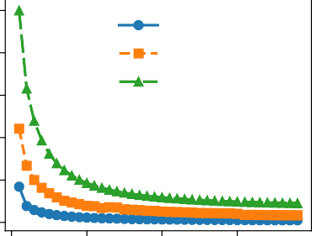
Impact of TPC Assignment on Latency
Increasing TPCs reduces latency
Workload spread across more SMs.
However, adding TPCs provides diminishing returns
Latency plateaus after a certain # of TPCs
The saturation point is model-dependent
ShuffleNet: 3 TPCs
ResNet34: 8 TPCs
MobileNetV2: 15 TPCs
Latency vs TPC Assignment
Example: 500 (128x128) images per batch
1000
Batch Latency (ms)
ShuffleNet ResNet34 MobileNetv2
800
600
400
200
0
0
10 20
30
Number of TPCs

Slide 7
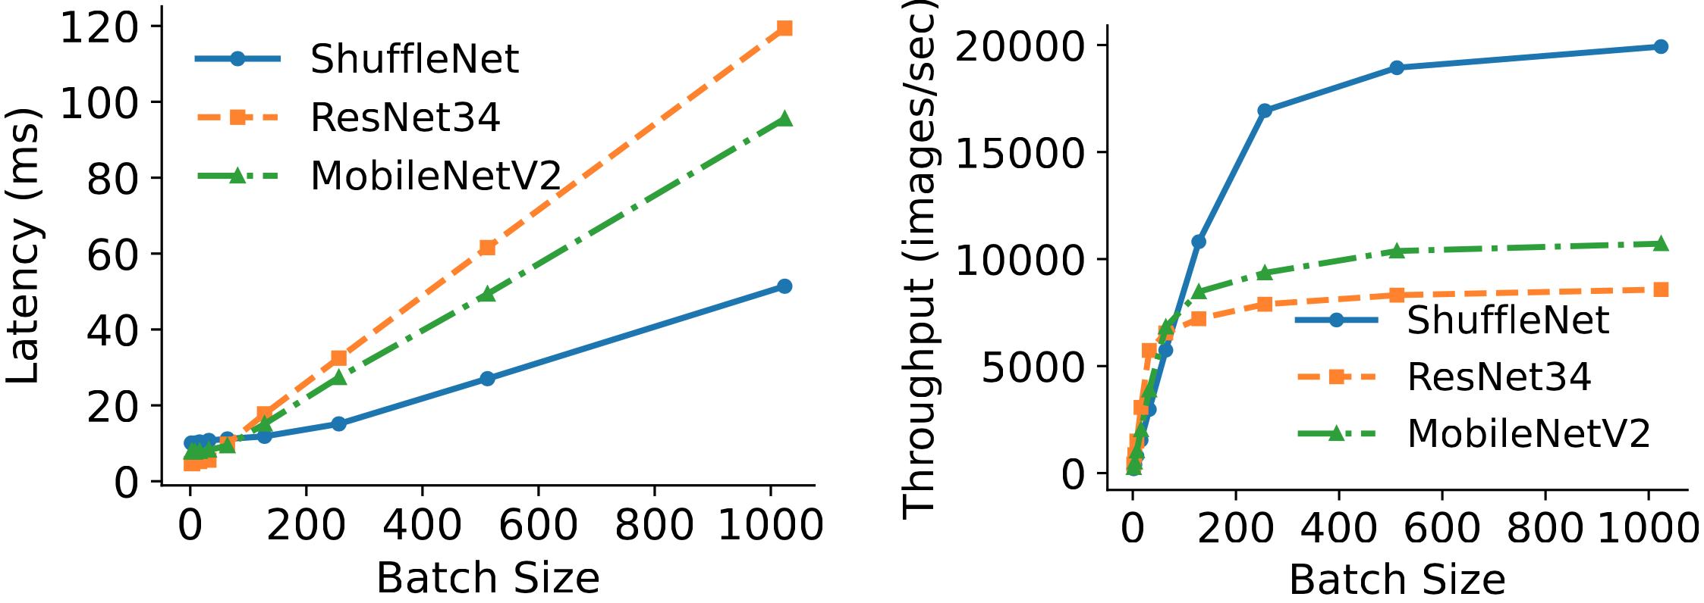
Impact of Batching on Latency and Throughput
Batching processes multiple inputs in a single forward pass:
Small batch sizes improve latency through better GPU utilization.
Large batch sizes increase latency, but improve throughput.

Slide 8













What About the Model Structure?
INPUT
Output
INPUT
Output
L0
L1
L2
Ln
L0
L1
L2
Ln
E1 E2 En
Output Output Output
Early-Exit Networks
Add intermediate classifiers inside the network.
Allow the model to stop early when confidence is high.
Reduce inference latency by skipping deeper layers.
Standard Deep Networks
Always process all layers
Wastes computation on “easy” inputs.
Can eliminate layers to reduce latency (impact on accuracy)
No flexibility to trade accuracy vs. speed.

Slide 9
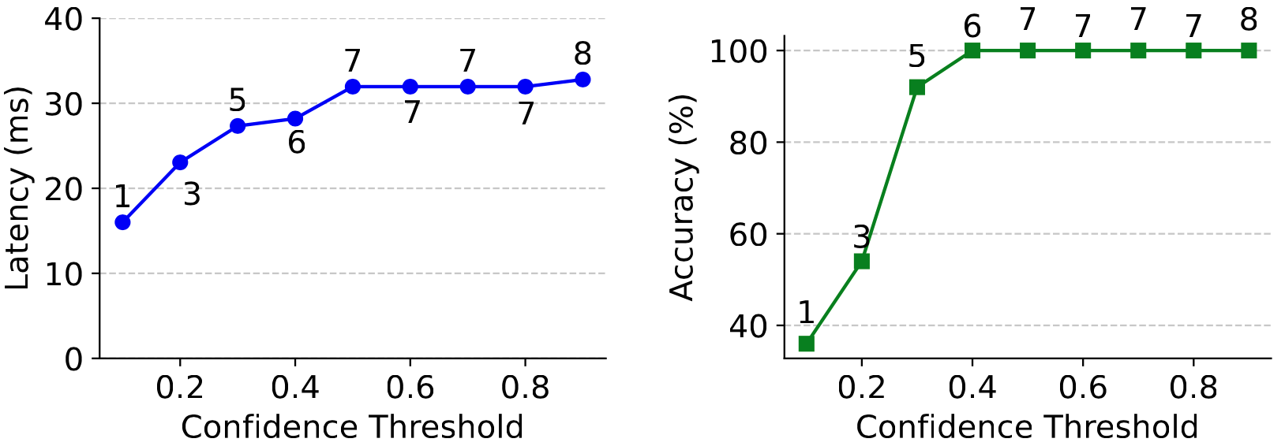
Impact of Confidence on Latency and Accuracy
Example: ResNet34
Numbers in the figures represent the early exit taken
Dynamically adjust the confidence threshold to trade off between latency and accuracy
Can help reduce latency without sacrificing accuracy (e.g., 0.4)

Slide 10
GPU Efficacy: A Unified Performance Metric
Prior work (GSLICE) introduced GPU Utilization Efficacy:
Throughput/latency.
This metric ignores online accuracy, which is critical for adaptive inference systems with early-exits.
Early-exits reduce latency but may slightly reduce accuracy; ignoring accuracy makes such models appear misleadingly efficient.
Throughput Latency
GE =
× Accuracy

Slide 11
Existing Solutions
Service Framework | Model Optimization. | GPU Resource Control | Deadlines?
TF-Serving | ✓ | ✗ | ✗
Triton | ✓ | ✓ | ✗
GPUColo | ✗ | ✓ | ✓
DeepRT | ✓ | ✗ | ✓
BCEdge | ✓ | ✗ | ✓
GSLICE | ✗ | ✓ | ✓
BranchyNet | ✓ | ✗ | ✗
SEEB-GPU (Ours) | ✓ | ✓ | ✓
Key Gap in Existing Solutions
No control over SM/TPC partitioning
No reduction of interference between tasks
No deadline-aware GPU allocation for real-time inference
Our solution SEEB-GPU fills these gaps.

Slide 12
Design Challenges
Problem:
For a set of inference requests, find the TPC allocation, confidence threshold, and batch size that jointly minimize latency and maximize accuracy under soft deadline constraints.
Mixed-Integer Non-Linear-Program (MINLP)
NP-Hard
Solution divided into 4 steps:
Task Aggregation
TPC Allocation
Batch and Confidence Selection
Inference Dispatch
Offloading Requests
Task Queue
D
C
B
A
Allocation
Example Ampere Architecture

Slide 13
SEEB-GPU: Aggregation
Devices
Input Request Aggregation
Request
High-level workflow
Aggregate inference requests using the same model
Sort by arrival time (earliest to latest)
Detect available TPCs
Trigger worker module

Slide 14
SEEB-GPU: TPC Allocation
Devices
Input Request Aggregation
online
SEEB-GPU
Worker
TPCs
Available
Request
GPU
TPC-0
SM SM
TPC-N
SM SM
TPC-1 TPC-2
SM SM SM SM
.
.
.
.
Worker Module (TPC Allocation)
For each aggregated task, distribute the available TPCs proportionally to their size
Generates per-task TPC masks
Ensures GPU spatial partitioning with negligible overhead
(Example: More images → more TPCs → lower latency)

Slide 15
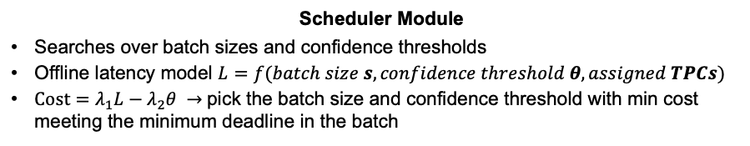
SEEB-GPU: Batch Size and Confidence
Devices
offline
Model Profiling
Input Request Aggregation
online
SEEB-GPU
Worker
Scheduler
TPCs
Available
Request
GPU
TPC-0
SM SM
TPC-N
SM SM
TPC-1 TPC-2
SM SM SM SM
.
.
.
.
Scheduler Module
Searches over batch sizes and confidence thresholds
Offline latency model $L=f(batch size s, confidence threshold θ, assigned TPCs)$
$Cost=λ_{1}L−λ_{2}θ →$pick the batch size and confidence threshold with min cost meeting the minimum deadline in the batch
Notes:
The batch size determines how many batches are dispatched. Consider 70 images and a batch size of 64. The latency model estimates the latency of the first batch of 64 and ensures it meets the minimum deadline. Then, the dispatcher will dispatch both the batch of 64 and the batch of 6. The GPU will then execute the 64 batch with the assigned TPC, after that, it will use the same TPCs to infer on the remaining 6. The second batch may miss the deadline, but this can be easily fixed by keeping the remaining images out of the first batch in queue, so they can be batched the next time new TPCs free up.

Slide 16
SEEB-GPU: Dispatch
Devices
offline
Model Profiling
Input Request Aggregation
online
SEEB-GPU
Worker
Scheduler
TPCs
Available
Request
Dispatcher
Models
GPU
TPC-0
SM SM
TPC-N
SM SM
TPC-1 TPC-2
SM SM SM SM
.
.
.
.
Dispatcher
Allocate the task to the GPU if a solution was found.
Fall back to a minimum confidence threshold to meet deadline if no solution was found

Slide 17
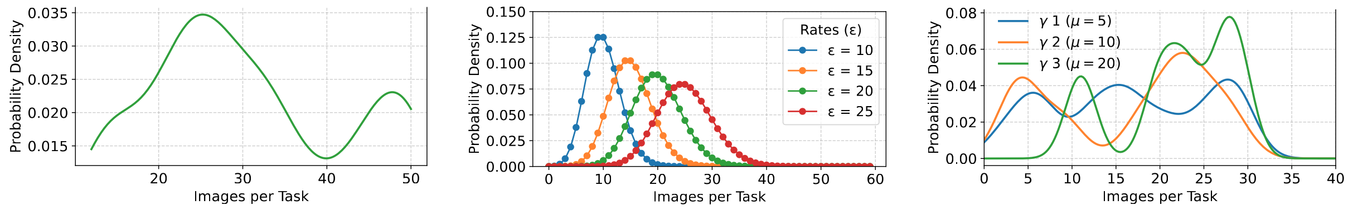
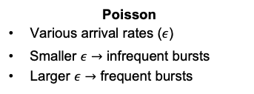
Experimental Setup
Experiments are performed on an RTX 3090 GPU (Ampere architecture).
82 SMs, arranged as 41 TPCs (two SMs per TPC).
GPU frequency is fixed at 1395 MHz during all experiments.
Spatial sharing is implemented using the libsmctrl library.
Various task traces. For each task: <arrival time, deadline, number of images, application>
PAI Trace
Real inference workload
Natural bursts and variance
Most realistic arrivals
Gamma
Bursty and clustered
Change the shape and scale parameters to control burstiness and timing
Poisson
Various arrival rates ($ε$)
Smaller $ε→$ infrequent bursts
Larger $ε→$ frequent bursts
Notes:
Each trace records the arrival time, deadline, number of images per task, and application type.
For the PAI-based traces, we first extract inter-arrival times from a production GPU cluster log (PAI). We then bootstrap new arrival sequences by sampling these empirical inter-arrival times with replacement, scaling them so that a 100-second window contains between 20 and 30 jobs, and finally compressing the resulting timeline so all arrivals lie within the interval [1, 100] seconds. Each job is assigned a relative deadline of 1.2 seconds after arrival. The job size (“number of images”) is sampled uniformly between 2 and 30, and each job is associated with one of four datasets (GTSRB, Animals, Adience, FER), chosen uniformly at random while ensuring that all datasets appear at least once whenever possible.

Slide 18
Workloads and Baselines
Baselines
Batch - NVIDIA Triton Inference Server
Minimal batch size for low latency.
No time/spatial sharing, no accuracy adaptation
DeepRT – Yang et al., SEC’21
EDF-based time-slicing + adaptive batching.
No spatial sharing, no accuracy adaptation
GSLICE – Dhakal et al., SCC’20
Spatial–temporal GPU sharing using MPS.
No model accuracy adaptation
BranchyNet – Teerapittayanon et al., ICPR’16
Dynamic early-exit inference for low latency.
No TPC or batching
DNN Workloads
Four representative real-world vision applications
Task | DNN Model
Animal classification¹ | ResNet50
Age classification² | ShuffleNet
Traffic sign classification³ | MobileNetV2
Emotion recognition⁴ | ResNet34
[1] Corrado (2019). Animals-10 dataset. https://www.kaggle.com/datasets/alessiocorrado99/animals10
[2] Eidinger et al. (2014), IEEE Transactions on information forensics and security 9, 12, 170–2179.
[3] Houben et al. (2013). International Joint Conference on Neural Networks (IJCNN).
[4] Goodfellow et al. (2013), In 20th international conference on Neural information Processing (ICONIP).
Notes:
Adience [15 ], Animals [ 9], GTSRB [24], and FER [ 19]

Slide 19
Evaluation on Real-World PAI Trace
Performance Comparison on PAI Trace
Metric | Batch | BranchyNet | DeepRT | GSLICE | SEEB-GPU
Latency (s) | 0.152 | 0.084 | 0.738 | 0.343 | 0.047
Throughput (tasks/s) | 1.061 | 1.097 | 1.096 | 1.097 | 1.094
Accuracy (%) | 96.26 | 76.62 | 96.29 | 96.29 | 83.53
GPU Efficacy | 6.74 | 10.00 | 1.64 | 2.95 | 19.58
SLA Violations (%) | 4.44 | 0.00 | 0.00 | 0.00 | 0.00
SEEB-GPU delivers comparable Throughput, but between
1.8x and 15x lower latency
9.6x and 12x higher GPU Efficacy
While maintaining 0% SLA (Service Level Agreements - deadline) violations.

Slide 20
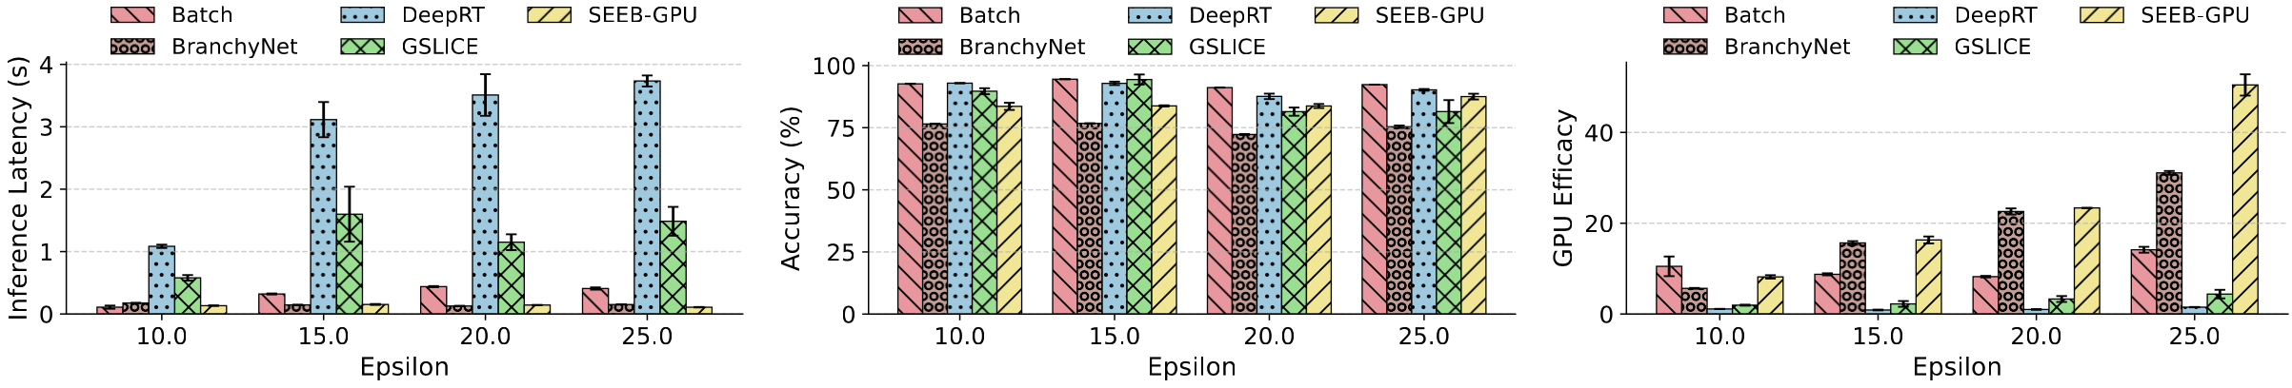
Evaluation on Poisson Trace
SEEB-GPU achieves the lowest latency across all Poisson arrival rates.
Similar to Branchynet, which has the lowest accuracy
GPU efficacy is consistently the highest, showing superior SM utilization at minimal accuracy loss.

Slide 21
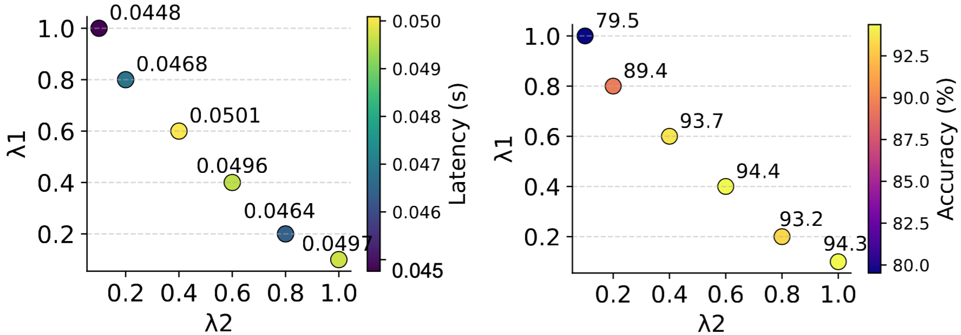
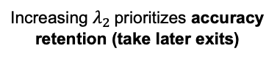
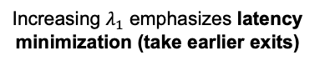

Sensitivity Analysis (PAI Trace)
$$Cost=λ_{1}L−λ_{2}θ$$
Configuration with the highest Accuracy/Latency Ratio (5-13% better)
Increasing $λ_{1}$ emphasizes latency minimization (take earlier exits)
Increasing $λ_{2}$ prioritizes accuracy retention (take later exits)

Slide 22
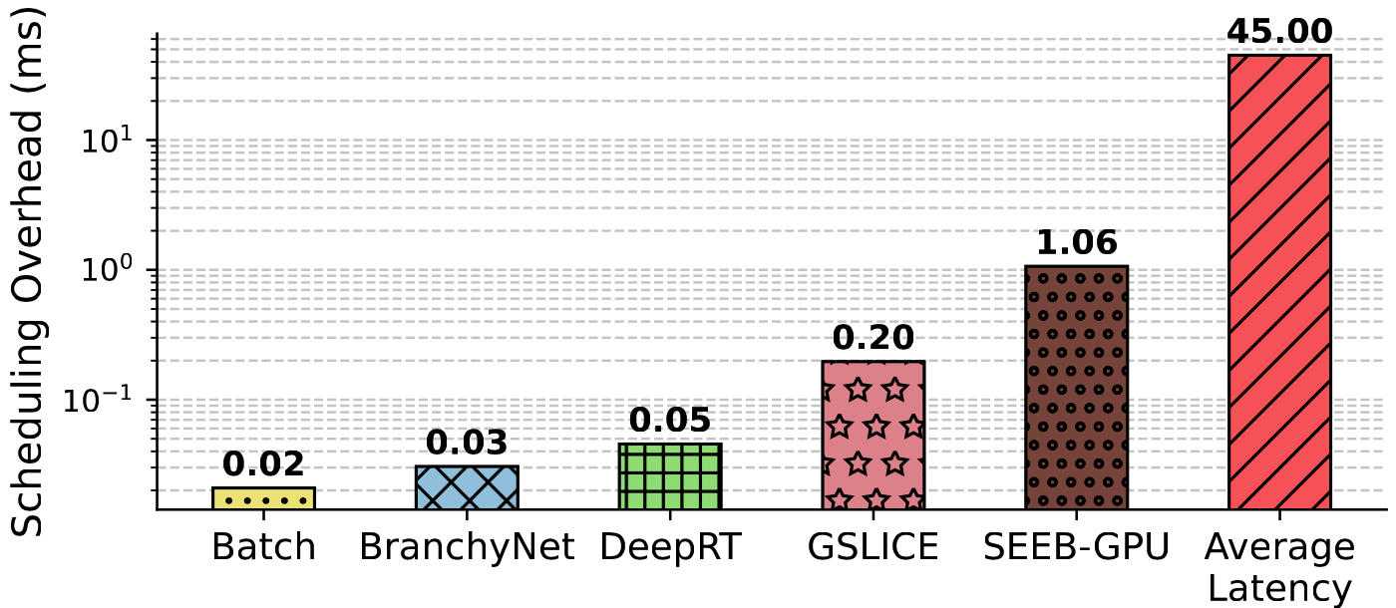
Overhead
SEEB-GPU has slightly higher overhead of 1ms due to the joint control of TPC, batch size, and confidence threshold.
Still negligible compared to the average batch latency of 45ms

Slide 23
Conclusion
SEEB-GPU jointly considers model optimization, deadlines, and GPU resource management to optimize edge GPU usage.
Fine-grained TPC masking reduces contention and ensures predictable latency.
Dynamic early-exits and batch size scheduling reduce latency while preserving accuracy and throughput.
Demonstrates consistent latency reduction, zero deadline violations, and strong GPU efficacy across diverse traces.

Slide 24
Thank You for Your Attention!
Questions?
24

Slide 25
Backup Slides

Slide 26
Discussion
Portability.
Our approach can be ported to AMD GPUs using CU masking, which is equivalent to TPC control on NVIDIA GPUs.
Periodicity.
The scheduler is currently designed for sporadic tasks, but can be adapted to periodic workloads by pre-allocating TPCs based on known arrival periods.
Co-Scheduling.
Our current design targets GPU-only scheduling. A natural next step is integrated CPU+GPU scheduling to assign tasks across both resources.
Power Consumption.
Power optimization is not included yet. Future work can incorporate DVFS or other energy-aware techniques.
Scalability.
The framework can scale to multi-node and cluster environments. Handling bandwidth variability will be key for distributed scalability.

Slide 27
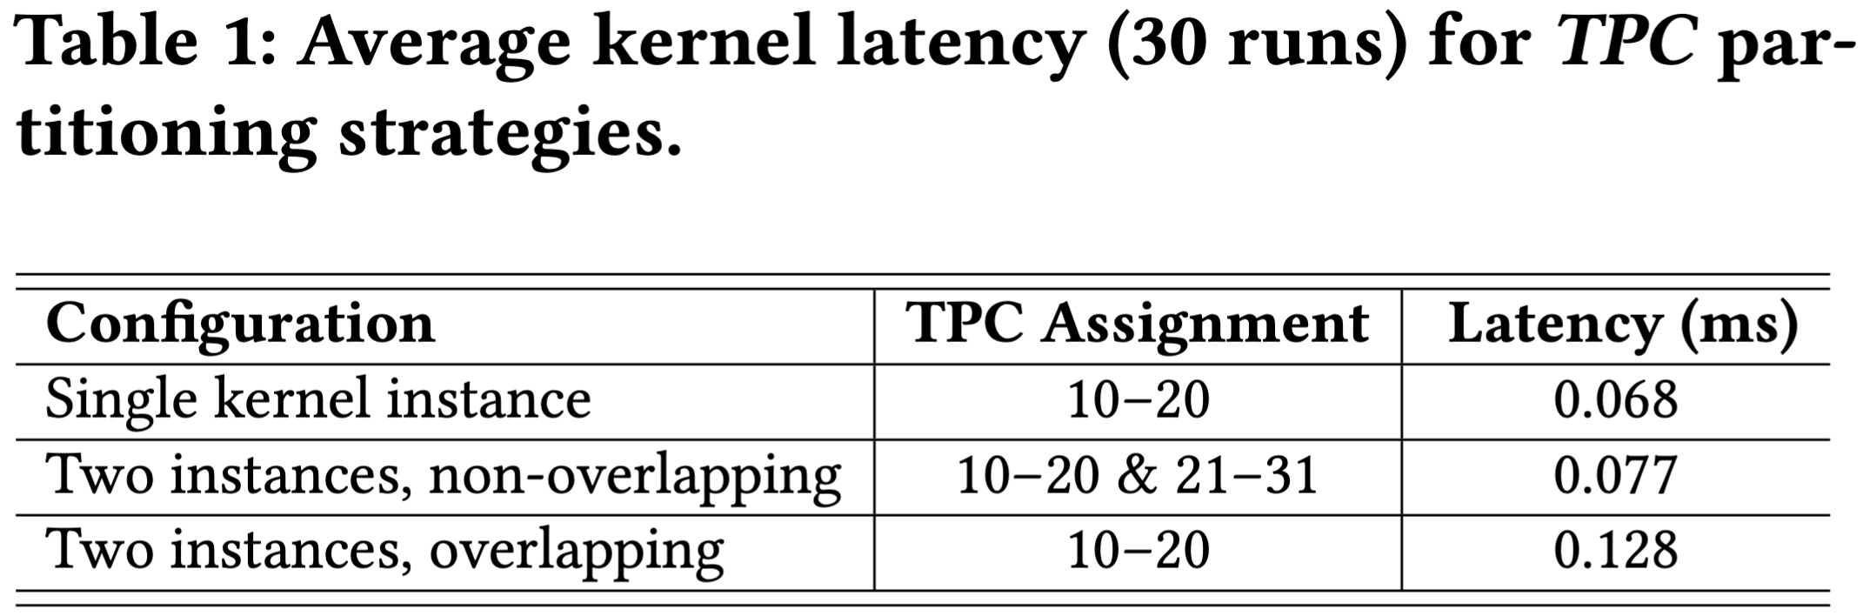
Impact of TPC Assignment on Latency
High contention overhead if different tasks are assigned the same TPCs

Slide 28
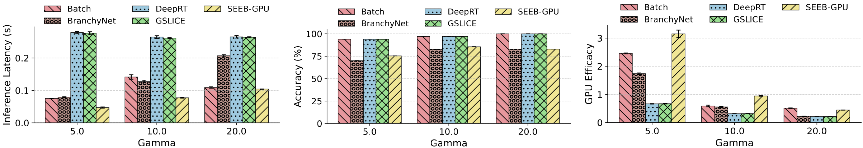
Evaluation on Gamma Trace
SEEB-GPU maintains the lowest latency even under highly bursty Gamma arrivals.
Accuracy remains stable across all Gamma parameters.
GPU efficacy is consistently the highest, demonstrating robustness under burstiness.

Slide 29
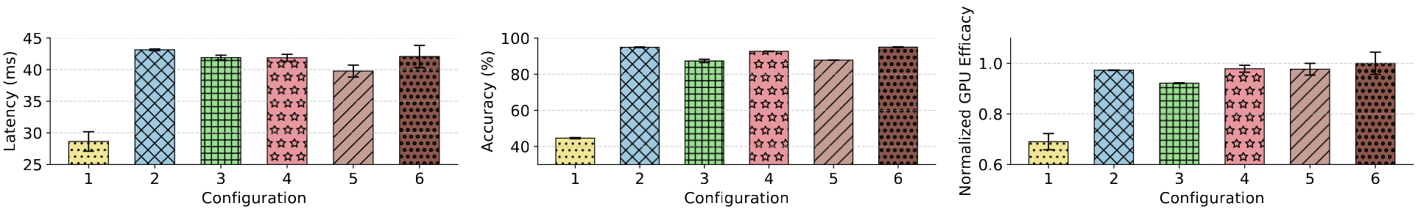
Ablation Study
Goal: Evaluate the contribution of each control knob: confidence threshold, batch size, and
TPC assignment.
Config | Confidence Threshold | Batch Size | TPC Assignment
1 | 0.3 (Fixed) | Tuned | Disabled
2 | 0.9 (Fixed) | Tuned | Disabled
3 | Tuned | 2 (Fixed) | Disabled
4 | Tuned | 128 (Fixed) | Disabled
5 | Tuned | Tuned | Disabled
6 | Tuned | Tuned | Enabled

